Slide 1
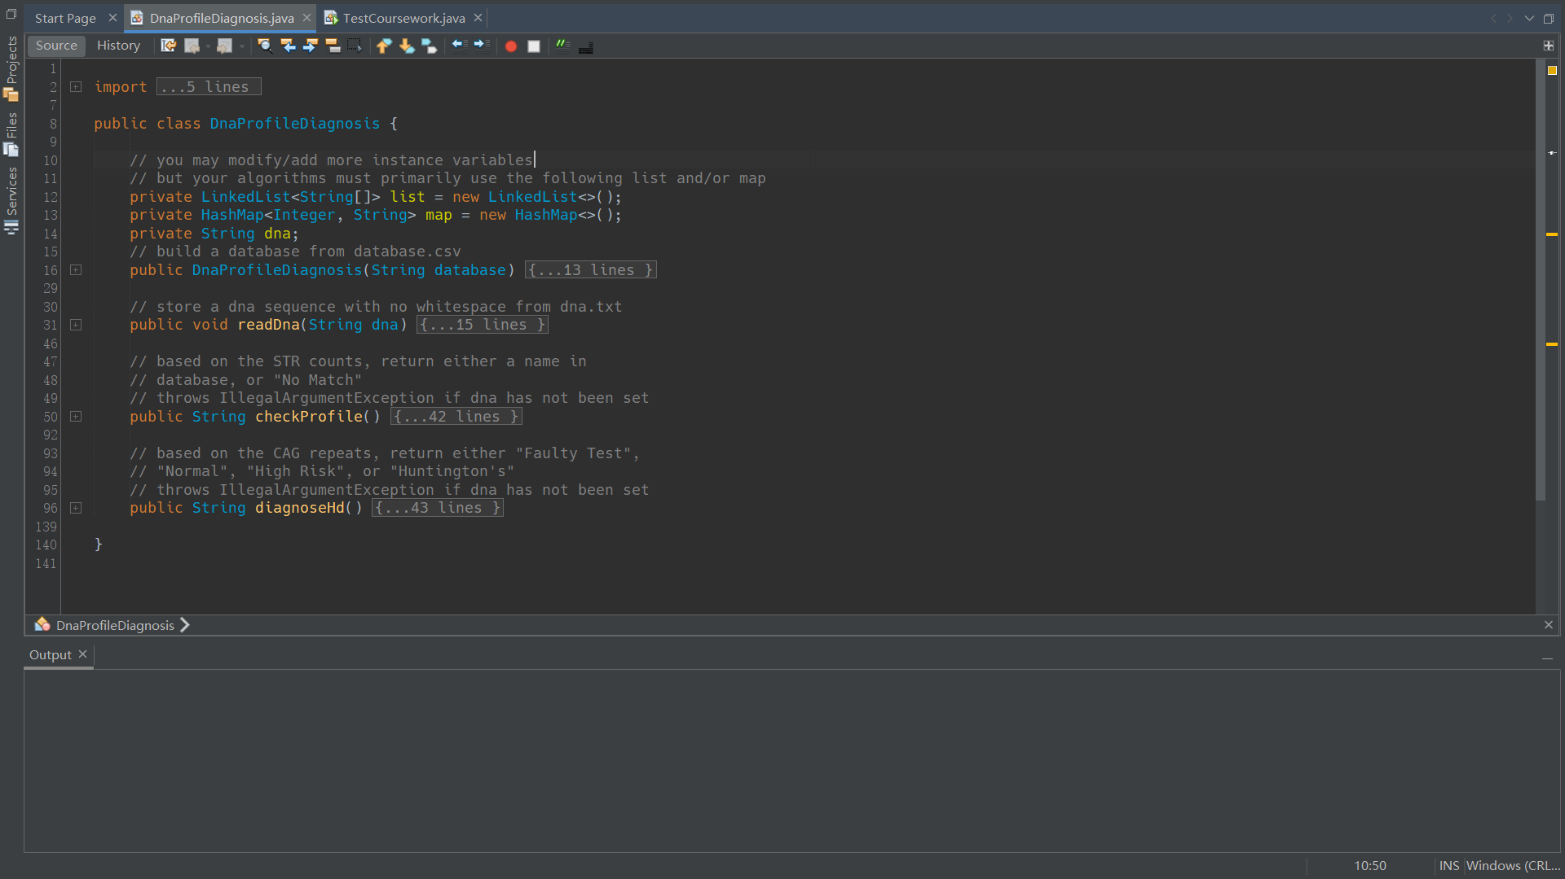
CW3
DNA Profiling
& Huntington's Disease Diagnosis
Zhirong Zhang 2143206
Discussions of the algorithms & Running time analysis
BUILD SUCCESSFUL (total time: 0 seconds)

Slide 2
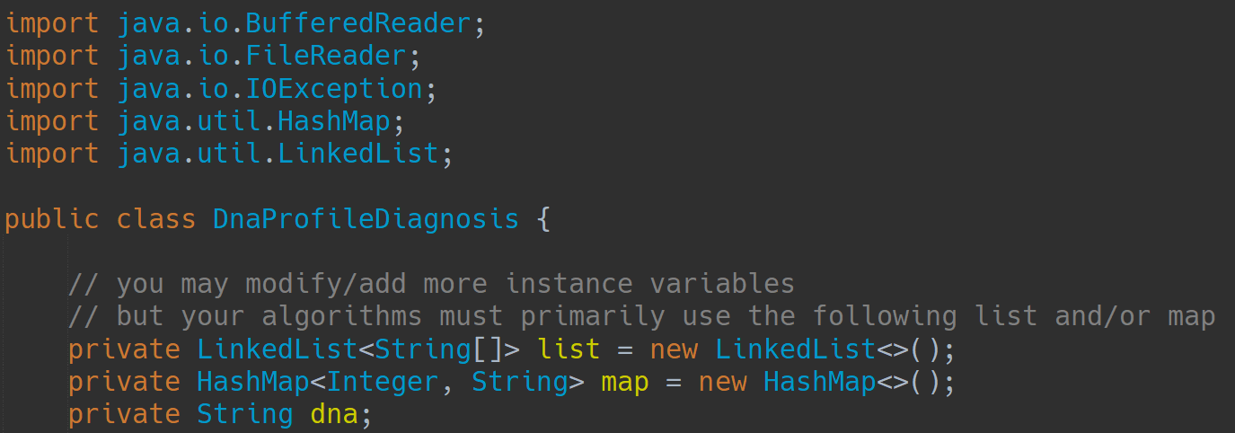
Imported Library & Instance variables
BUILD SUCCESSFUL (total time: 0 seconds)

Slide 3
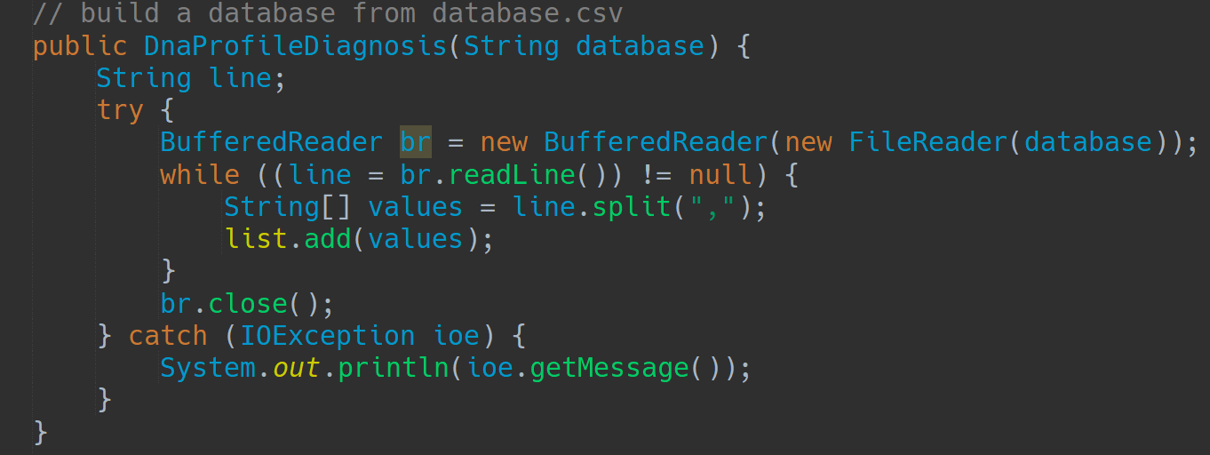
Constructor
O(1)
O(n)
O(k)
O(kn)
O(1)
BUILD SUCCESSFUL (total running time: O(kn))
k = the length of the line
n = the number of lines

Slide 4
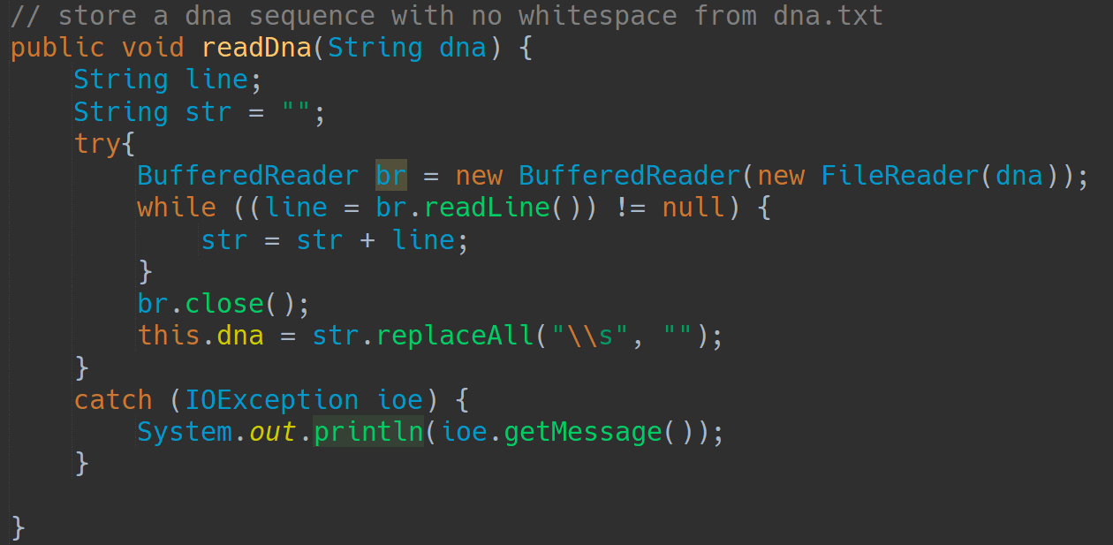
Method (DNA reader)
O(1)
O(t)
O(t+r)
O(1)
O(r)
BUILD SUCCESSFUL (total running time: O(t+r))
r = the length of str
t = the number of lines

Slide 5
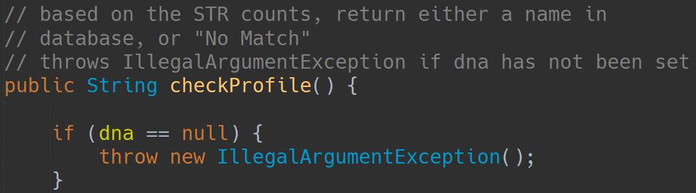
Method (Profile checker Part I)
BUILDING.

Slide 6
Method (Profile checker Part II)
name | AAGT | ACTC | TATG
Michael | 3 | 10 | 8
Franklin | 4 | 2 | 8
Trevor | 5 | 11 | 9
BUILDING..

Slide 7
Method (Profile checker Part II)
j
i
name (0,0) | AAGT (0,1) | ACTC (0,2) | TATG (0,3)
Michael (1,0) | 3 (1,1) | 10 (1,2) | 8 (1,3)
Franklin (2,0) | 4 (2,1) | 2 (2,2) | 8 (2,3)
Trevor (3,0) | 5 (3,1) | 11 (3,2) | 9 (3,3)
list.get( i )[ j ]
BUILDING..

Slide 8
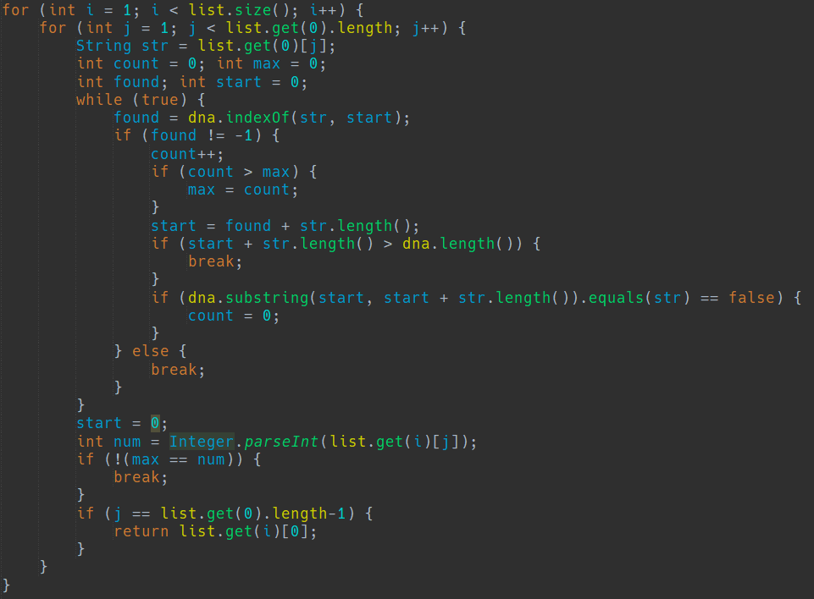
Method (Profile checker Part II)
O(z)
O(a)
O(d/s)
O(d)
O(1)
z = list size
a = the length of String array
d = dna string length
s = STR string length
BUILDING…

Slide 9

Method (Profile checker Part III)
O(1)
z = list size
a = the length of String array
d = dna string length
s = STR string length
BUILD SUCCESSFUL (total running time: O(azd²/s))

Slide 10
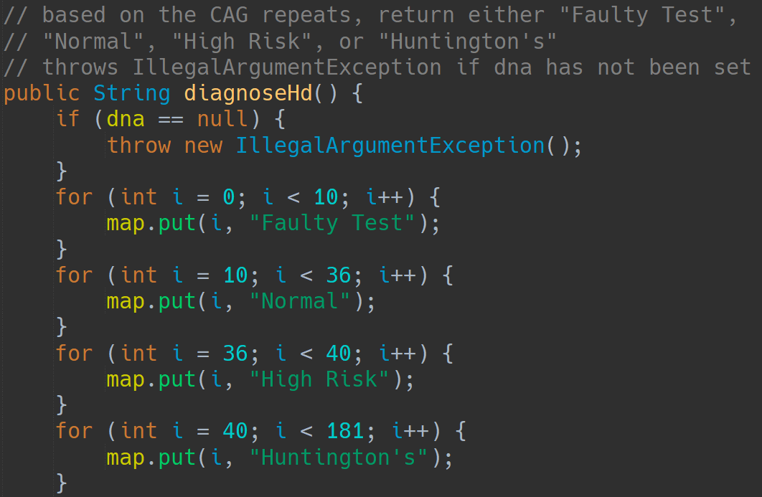
Method (Huntington's Disease Diagnosis Part I)
Can be replaced by some if statements
followed by return statements
(which is probably faster)
O(1)
O(1)
O(1)
O(1)
BUILDING.

Slide 11
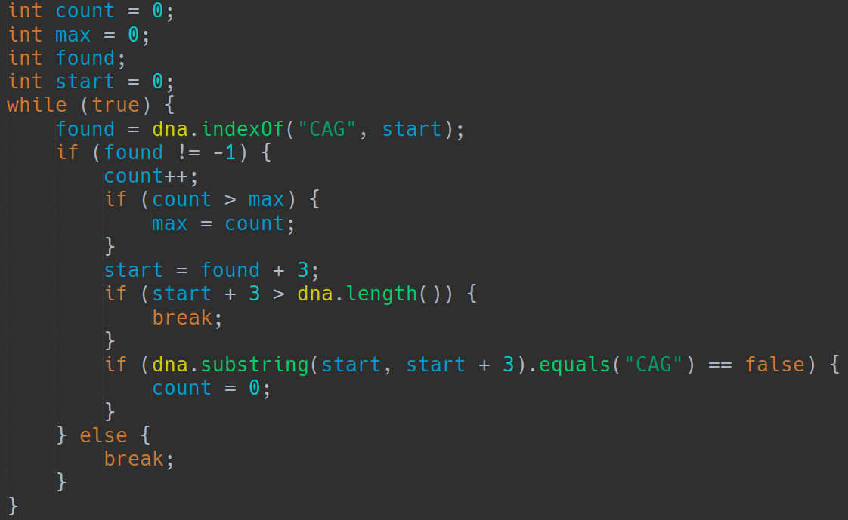
Method (Huntington's Disease Diagnosis Part II)
O(d/3)
O(d)
O(d)
O(1)
BUILDING..
d = dna string length

Slide 12
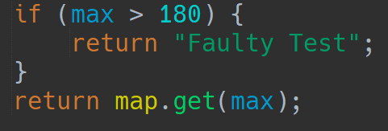
Method (Huntington's Disease Diagnosis Part III)
O(1)
O(1)
BUILD SUCCESSFUL (total running time: O(d²/3) O(d²))
d = dna string length

Slide 13
Thank you for your time
GOOD LUCK, Mr. Anderson
THIS POWERPOINT WILL SELF-DESTRUCT IN FIVE SECONDS…

